Slide 1


Customer Impact Analysis of Performance Issues
Group Alpha
Tolu
Emma
James

Slide 2

Objective
Analyze performance issues and their impact on customers
Key Focus Areas
Median download speed during peak hours (8 PM - 10 PM).
Performance variation by broadband type and location.
Percentage of customers hitting the advertised speed.

Slide 3
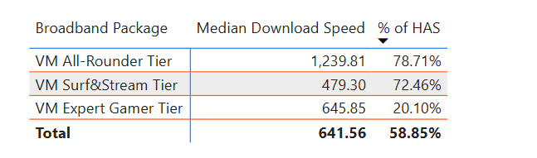
Data Insights

Slide 4
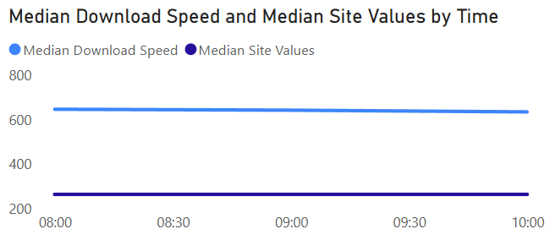
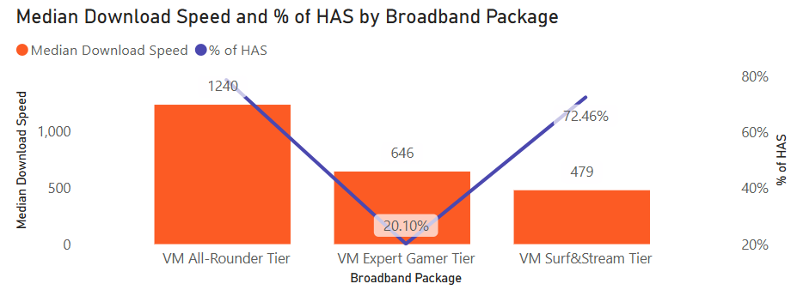
Visual Aids

Slide 5
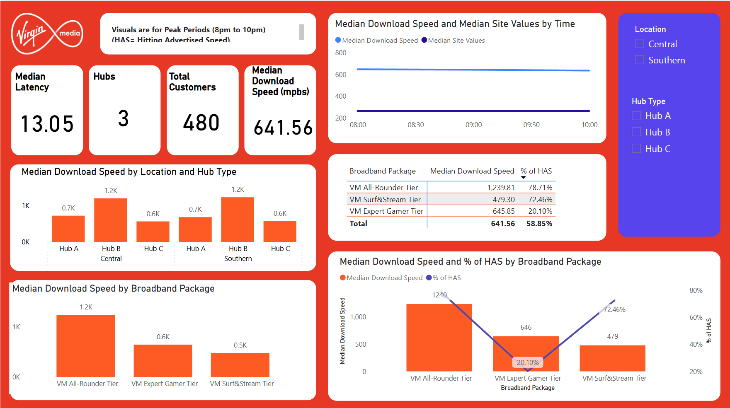
Dashboard

Slide 6

Thank you
Presenter name
Email address
Website

